Slide 1

A Predictive Model of Road Traffic Accidents Using Surrogate Safety Measures
By Prithviraj
Under the guidance of Dr. Ranju Mohan
Dept. of Data and Computational Science
1

Slide 2
Agenda
Introduction
System Design
Project Flow
Results
Areas of Growth & Primary Goals
Presentation Title

Slide 3
Introduction
The project aims to develop a predictive model using machine learning that can estimate the likelihood of road accidents at micro level (intersections and mid blocks) and identification of accident-prone areas at macro level (city network).
Surrogate Safety Measures (SSM) which are indirect indicators of potential crash occurrences and estimated from traffic flow characteristics, road geometry, and driver behavior, will be used to predict the risk of accidents before they occur.
SSM are important for traffic safety evaluation, largely due to the lack of reliable statistical safety models in many cases. This is particularly true for transportation facilities with complex site characteristics and/or nontraditional traffic safety treatments, where limited or no historical crash data is available.
SSM include factors as associated with traffic flow characteristics (e.g., speed, volume), road geometry (e.g., curves, slopes), weather conditions (e.g., rain, fog), driver behavior (e.g., aggressive driving, distraction), and other related variables that can influence the likelihood of road accidents.
Implementing the developed model into a practical application, such as a Traffic Management System, which can provide real-time predictions of road accident risks to traffic authorities, or other relevant stakeholders.
By leveraging the power of data and analytics, SSM has gained attention as a promising approach to improve road safety and save lives.

Slide 4
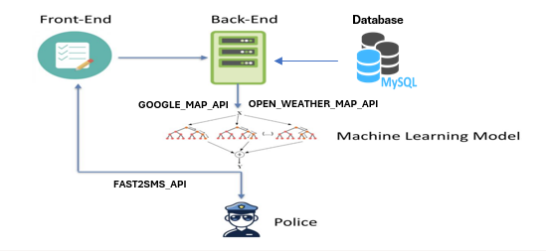
System Design
Architecture

Slide 5





Project Flow
Data Collection and Data Preprocessing
Feature Selection
Model Development
Model Evaluation and Deployment
Model Validation

Slide 6


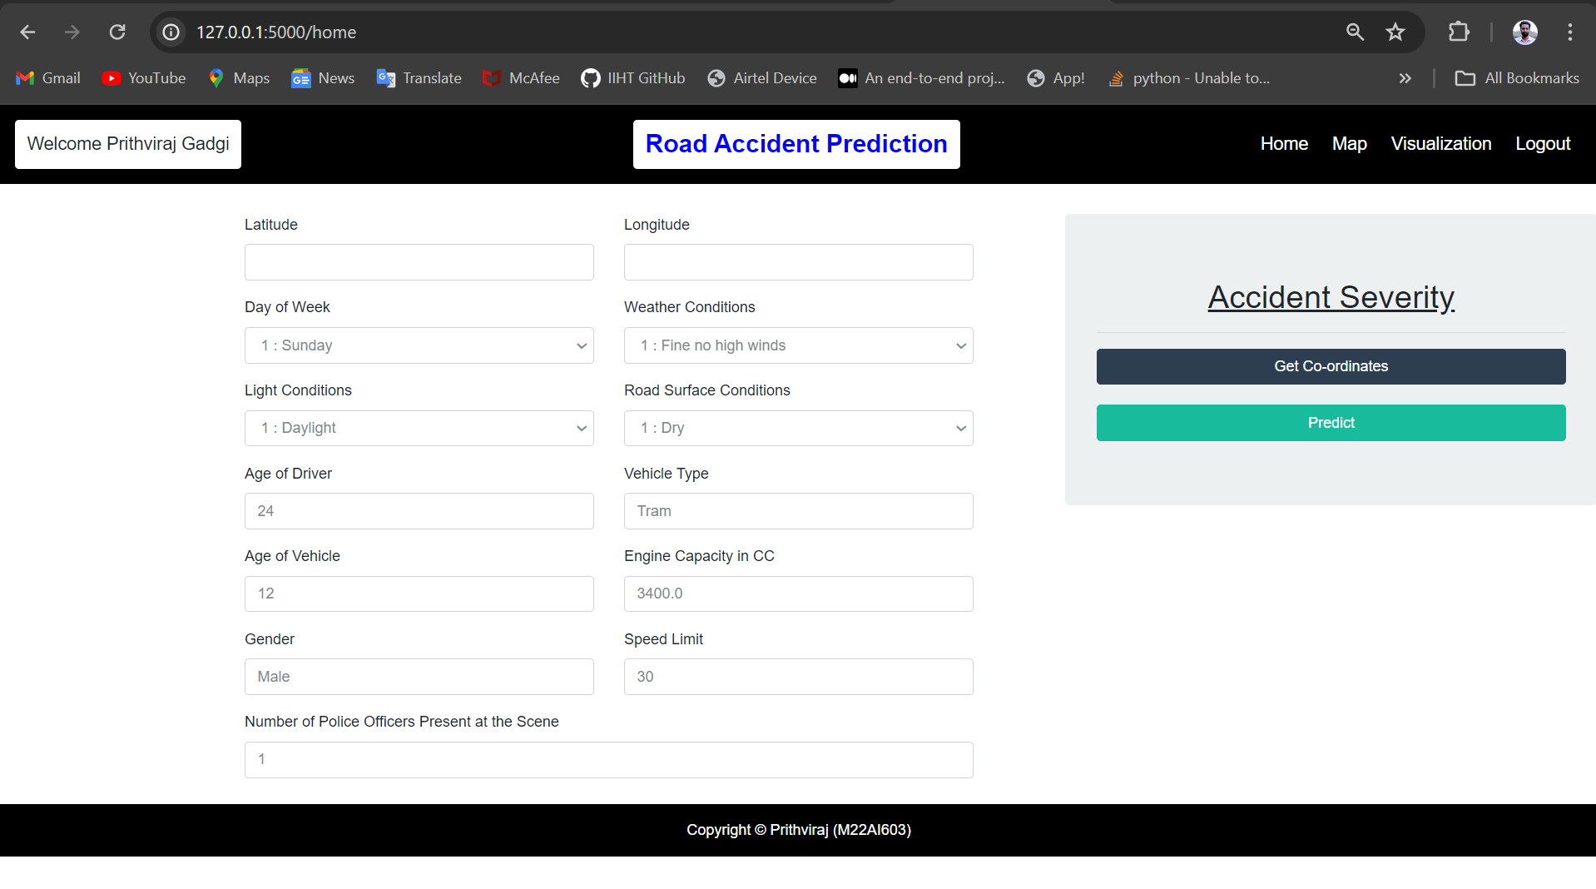
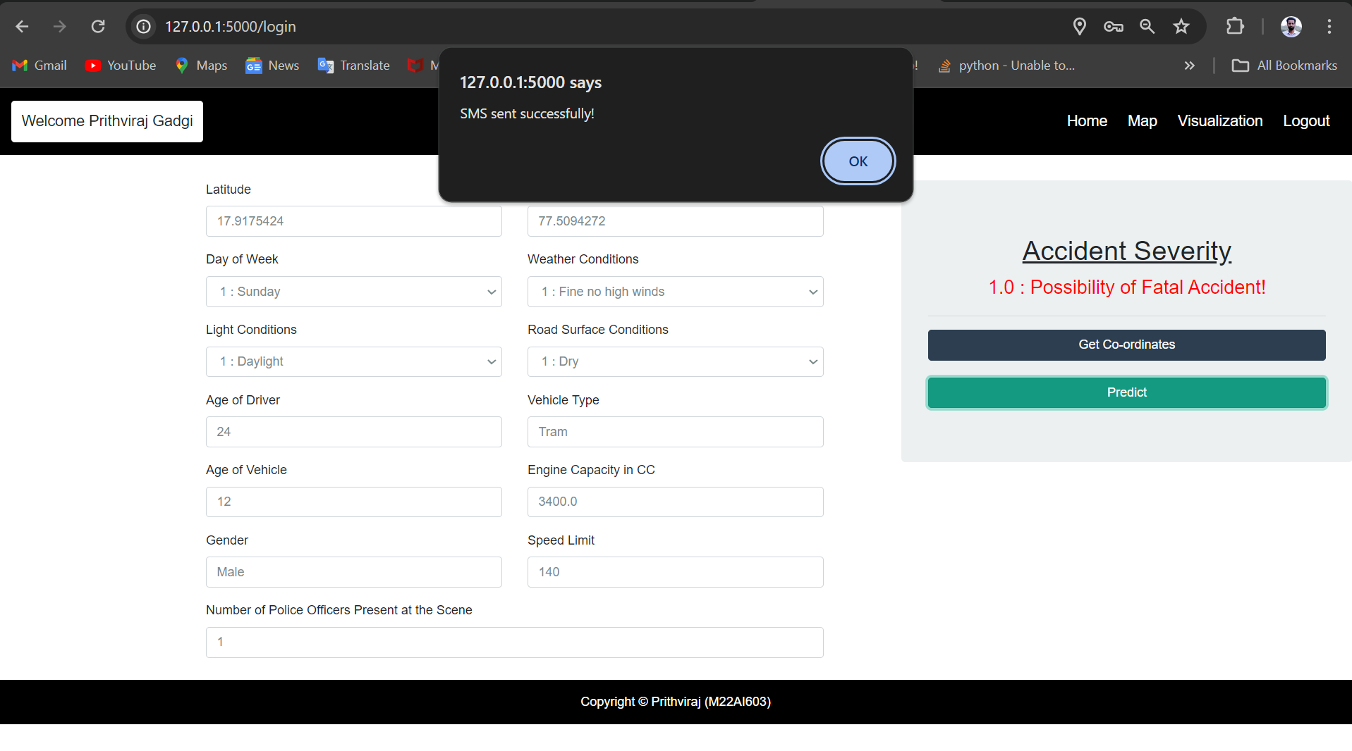
Results

Slide 7
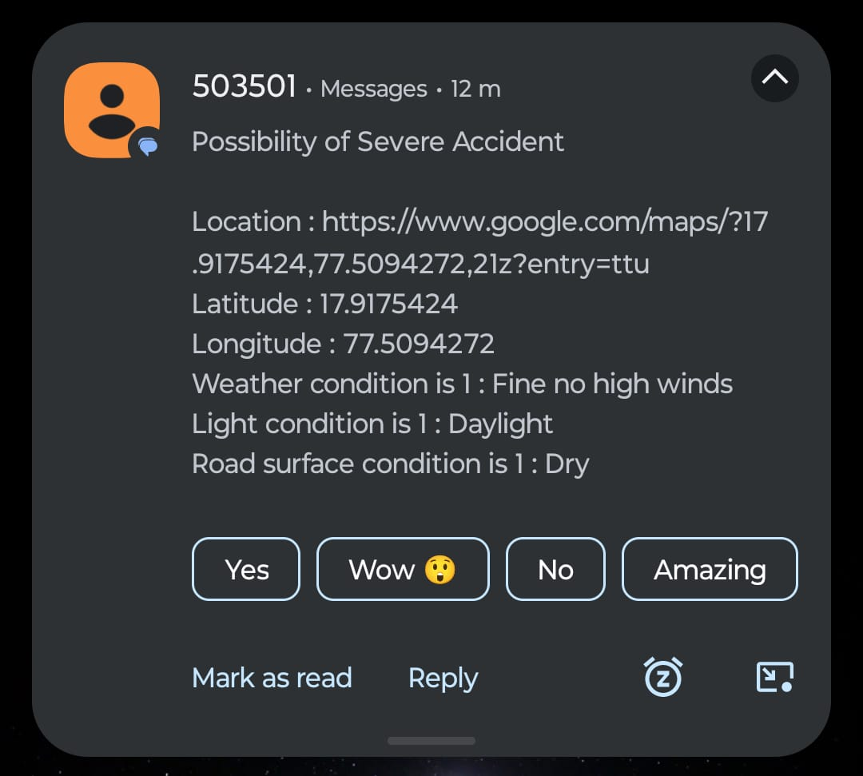
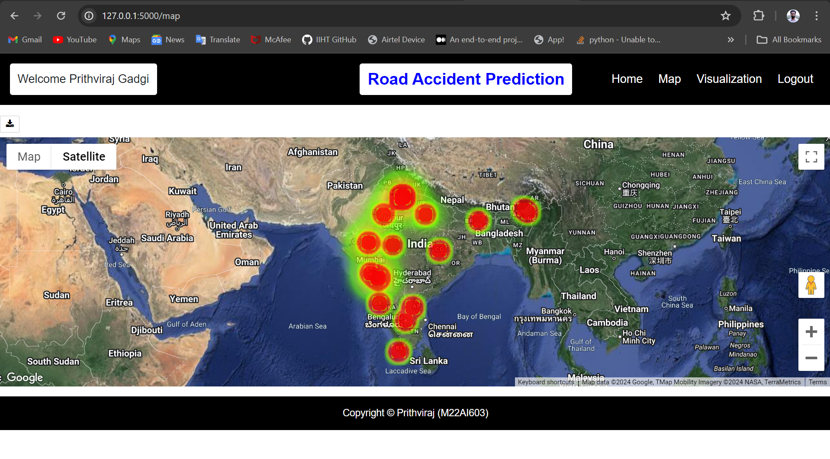
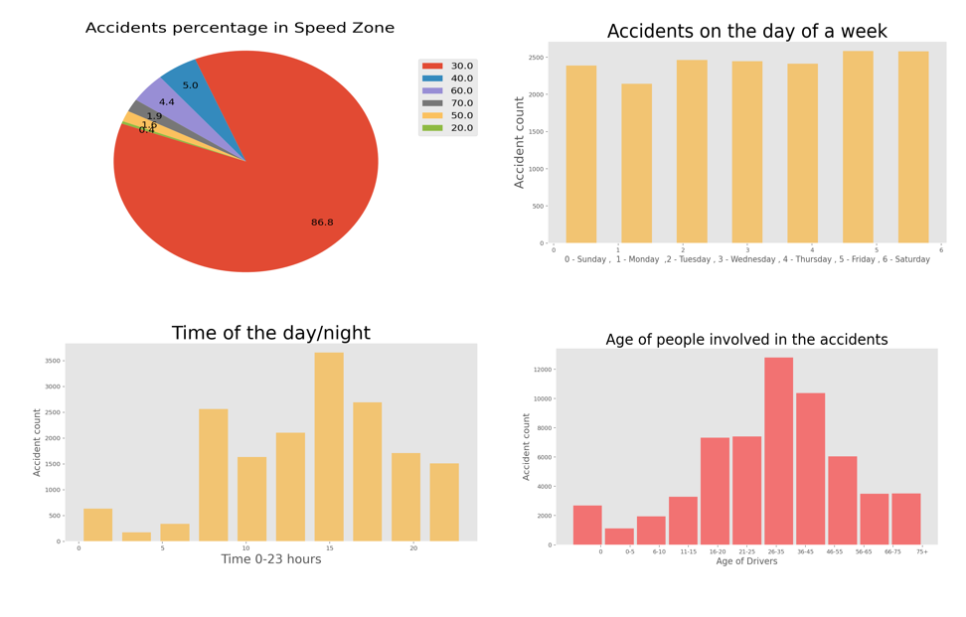
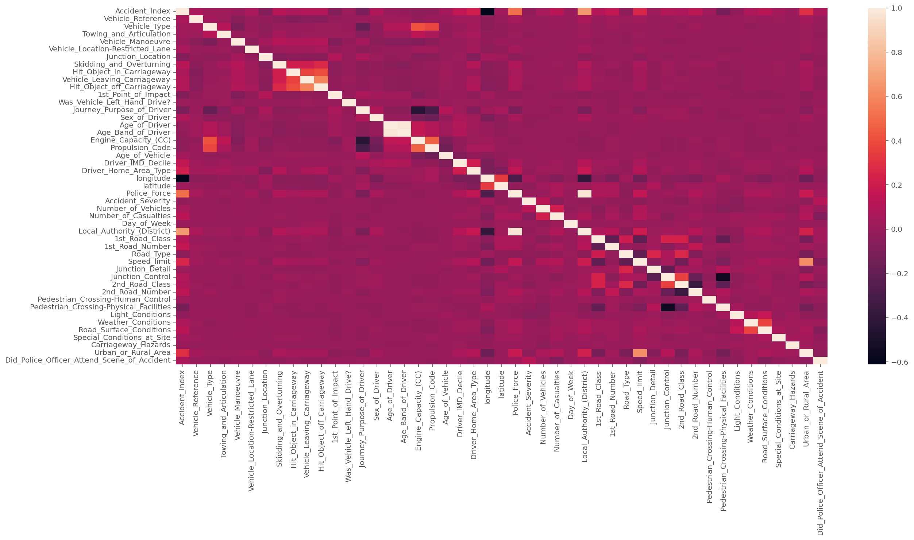
Results

Slide 8

Areas of Growth
Advanced Feature Engineering
Integration of IoT Technologies
Continued advancements in feature engineering techniques.
Exploring feature selection methods by considering temporal and spatial dependencies.
Incorporating domain-specific knowledge to capture the complex dynamics of traffic accidents.
Integration of IoT can help in real-time data collection, real-time alerts and interventions.
It can improve communication capabilities by using sensor networks and infrastructure such as connected vehicles and smart traffic signals.
Multi-modal and Multi-source Data Fusion
Incorporation of External Factors
Integrating data from multiple sources and modes of transportation, such as pedestrian and cyclist data.
By fusing data from various transportation modes and sources, predictive models can capture the interactions and interdependencies that contribute to accidents across different road user groups.
Weather conditions, road construction, and special events, can enhance the predictive capabilities of the model.
By integrating these external factors into the modelling process, the models can provide more accurate and context-aware predictions.
A Predictive Model of Road Traffic Accidents Using Surrogate Safety Measures

Slide 9




Primary Goals
Improved road safety
The ultimate goal is to prevent road traffic accidents and minimize their occurrence by identifying the factors and conditions that contribute to accidents through surrogate safety measures.
Enhancing road safety is a crucial objective. Predictive models help in understanding accident patterns and hotspots, enabling transportation authorities to prioritize safety improvements in specific areas.
Data-driven decision making
Developing robust predictive models promotes data-driven decision making in road safety management.
This reduces reliance on intuition and helps in prioritizing interventions and allocating resources more effectively.
Resource allocation
Can help in identifying high-risk areas or time periods prone to accidents, authorities can allocate their resources where they are most needed and can have the greatest impact..
Evaluation of safety interventions
By comparing the predicted accident occurrences before and after implementing safety improvements, authorities can assess the impact of their interventions and make adjustments accordingly.

Slide 10
Thank You
Prithviraj
m22ai603@iitj.ac.in

